Slide 1
Reproduction in flowering plants
Chapter 16 / Part Two

Slide 2
The flower and types of reproduction:
• Flower: Is the reproductive structure of a plant Function:
(a) attracting insects
(b) producing seeds
(c) producing pollen
(d) producing nectar
Flowers are either:
• Bisexual or hermaphrodite: A condition where male and female reproductive organs are found in the same flower
• Unisexual flower: A flower with either male or female reproductive organs

Slide 3
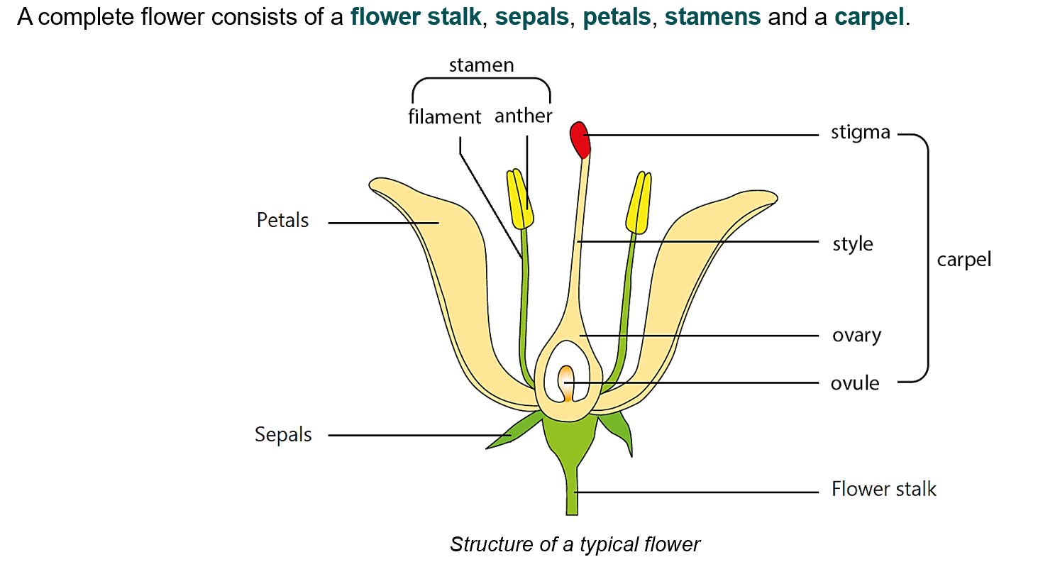
What is a complete flower?

Slide 4
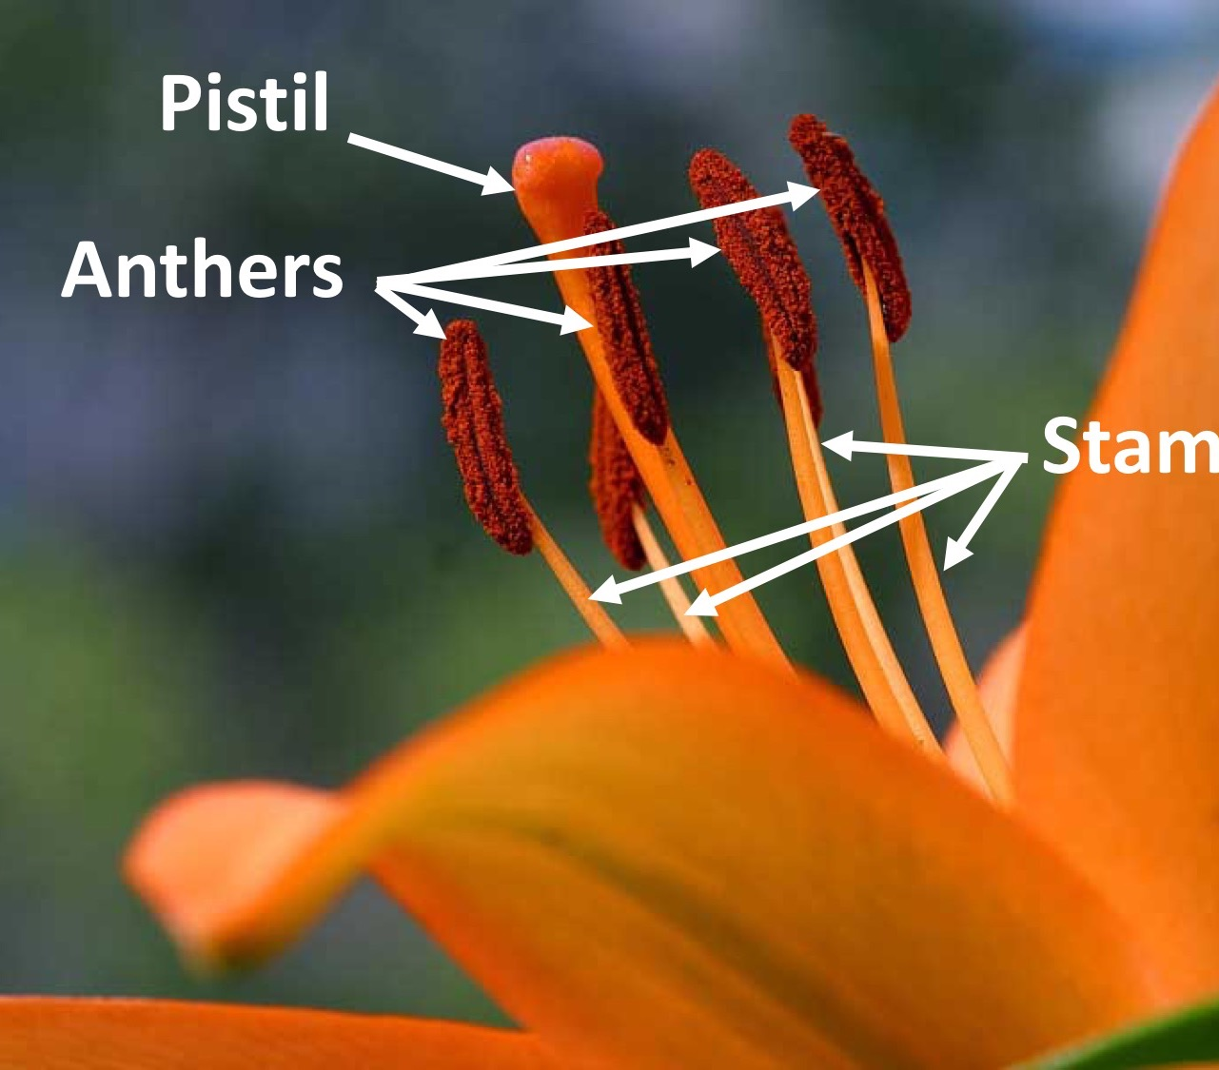
Parts of the flower
• Stamens: They are male reproductive organs of a flower. Each stamen has a stalk called filament, with an anther on the end.
Each anther consists of four pollen sacs in which the pollen grains are produced by cell division (meioses).
When the anthers are ripe, the pollen sacs split open and release the pollen.

Slide 5
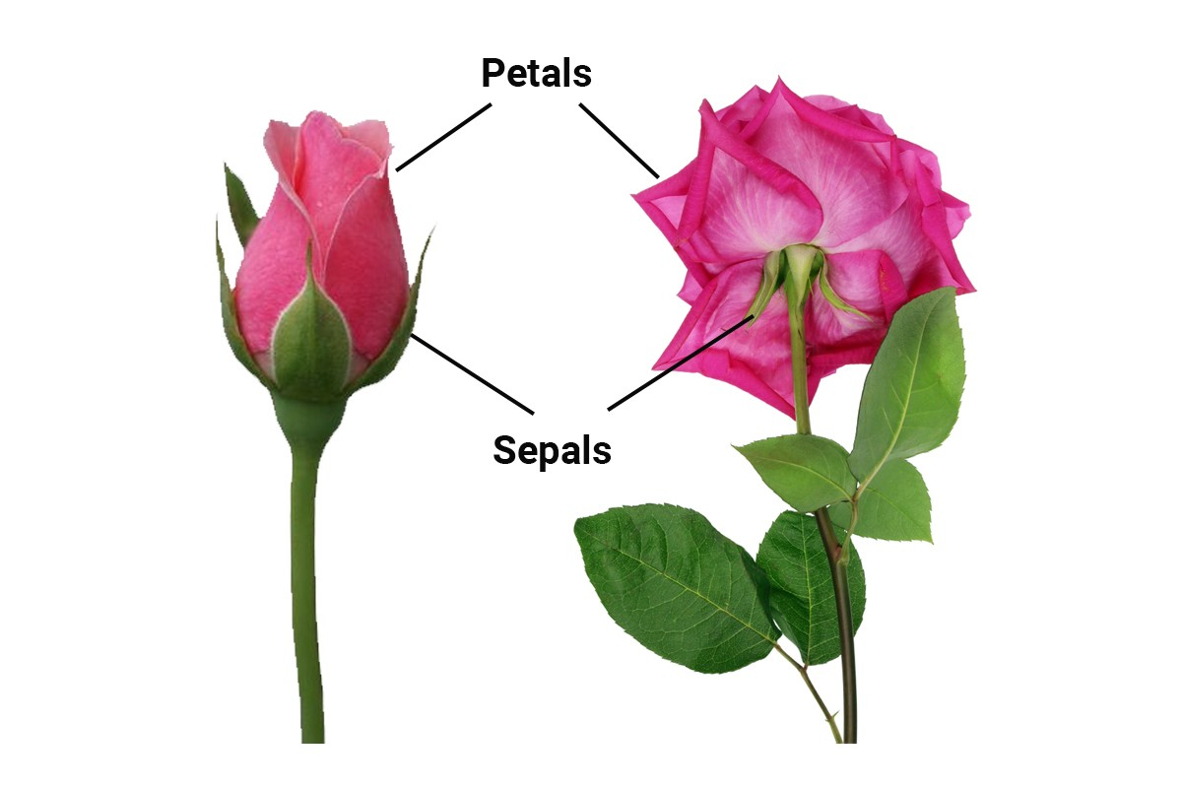
Parts of the flower
• Petals: They are usually bright coloured and sometimes scented. the colour and scent of the petal attract insects to the flower, the insects may bring about pollination.
Note: the flower of grasses and many trees don't have petals but small leaf-like structure called bracts, which enclose the reproductive organ.
• Sepals: These are green leaflets which lie outside the petals. They protect the flower when it is in the bud.

Slide 6
Parts of the flower
• Carpel: These are the female reproductive organ. A carpel consists of an ovary, bearing a style and a stigma. Inside the ovary there are one or more ovules. The ovule will become a seed, and the whole ovary will become a fruit. The style and stigma project from the top of the ovary. The stigma has a sticky surface and pollen grains stick to it during pollination.
• Receptacle: It is the expanded end of a flower stalk. The other structures of the flower are attached to it. In few cases after fertilization, the receptacle becomes fleshy and edible e.g. : apple and pear.

Slide 7
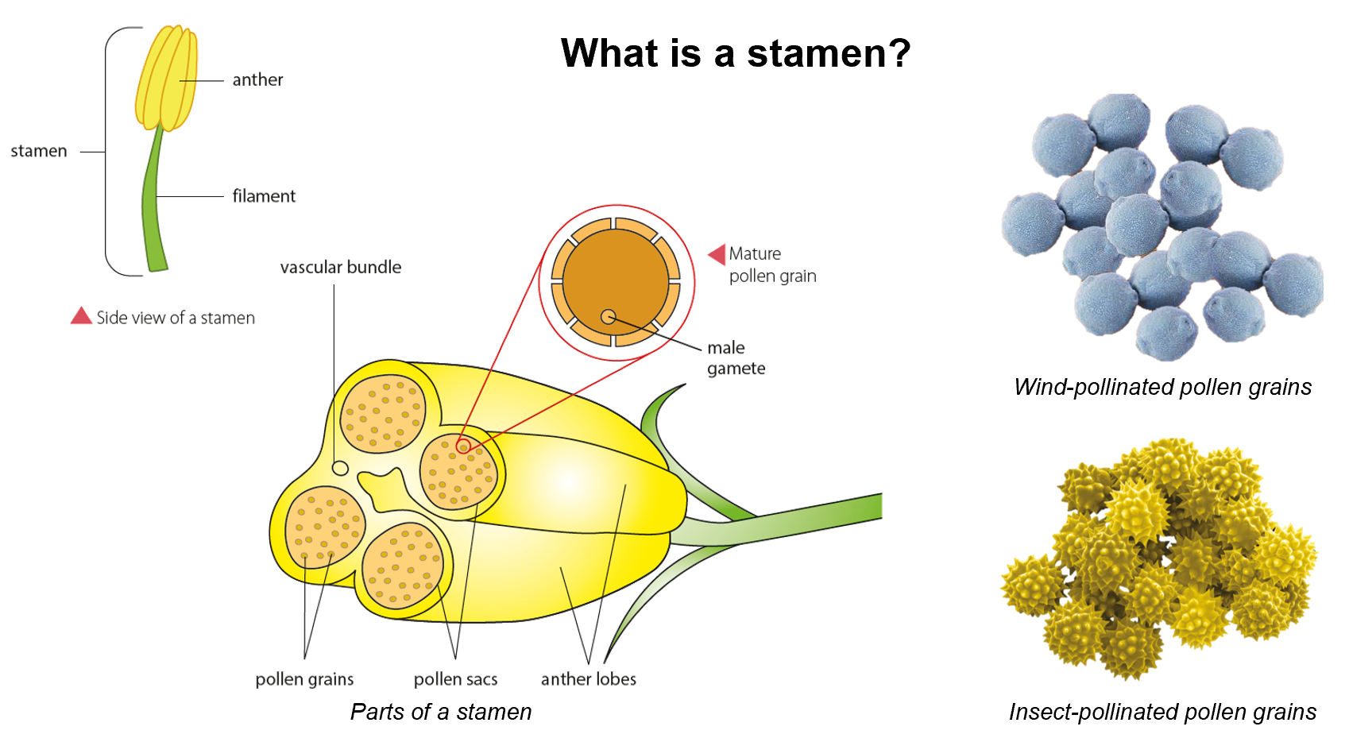

Slide 8
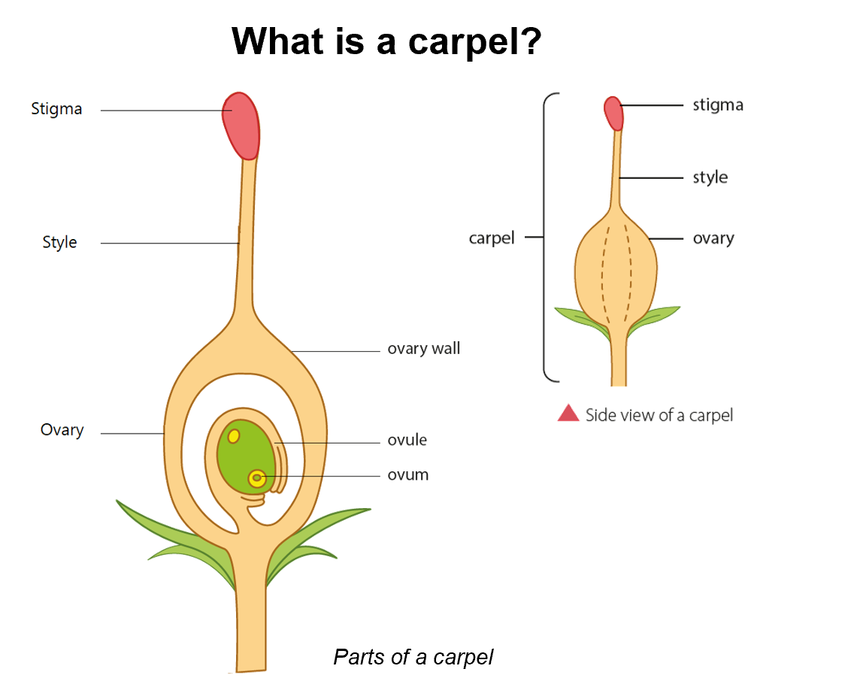

Slide 9
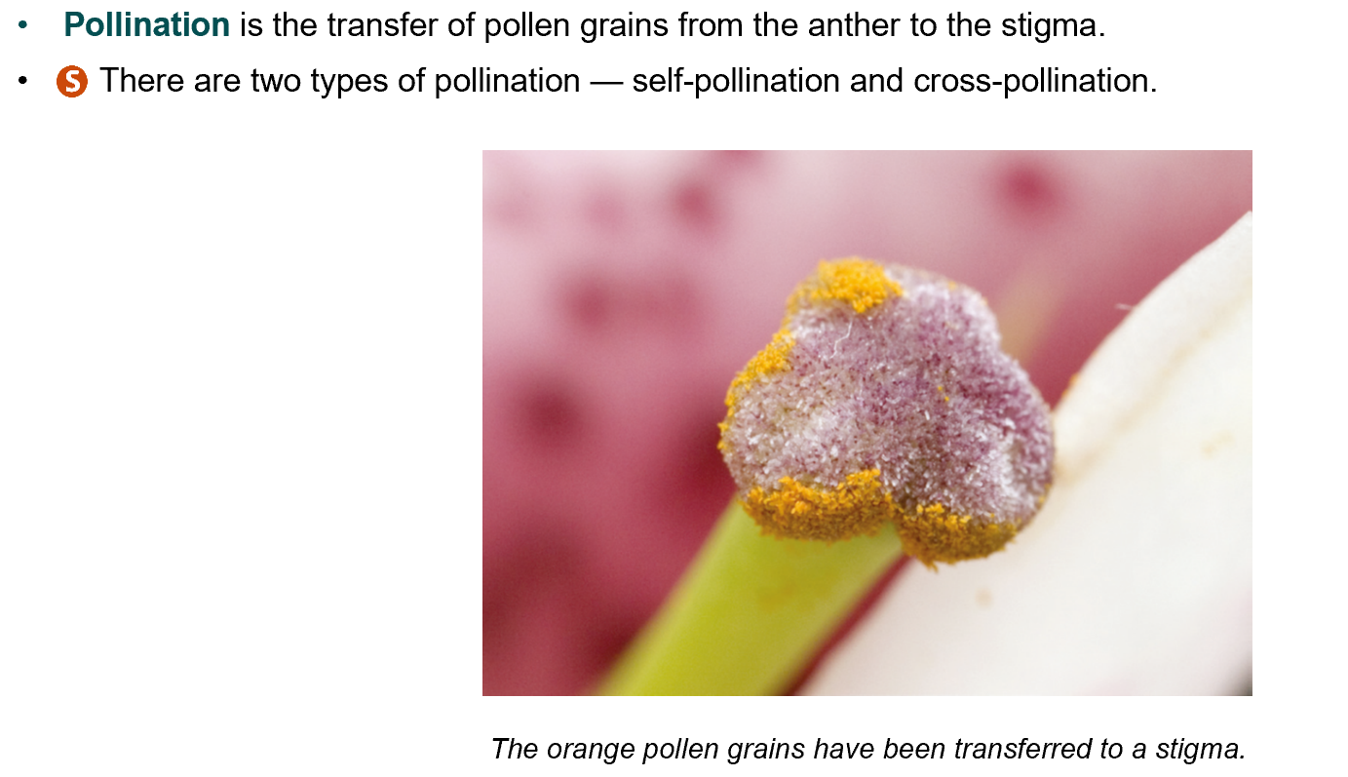
Pollination

Slide 10
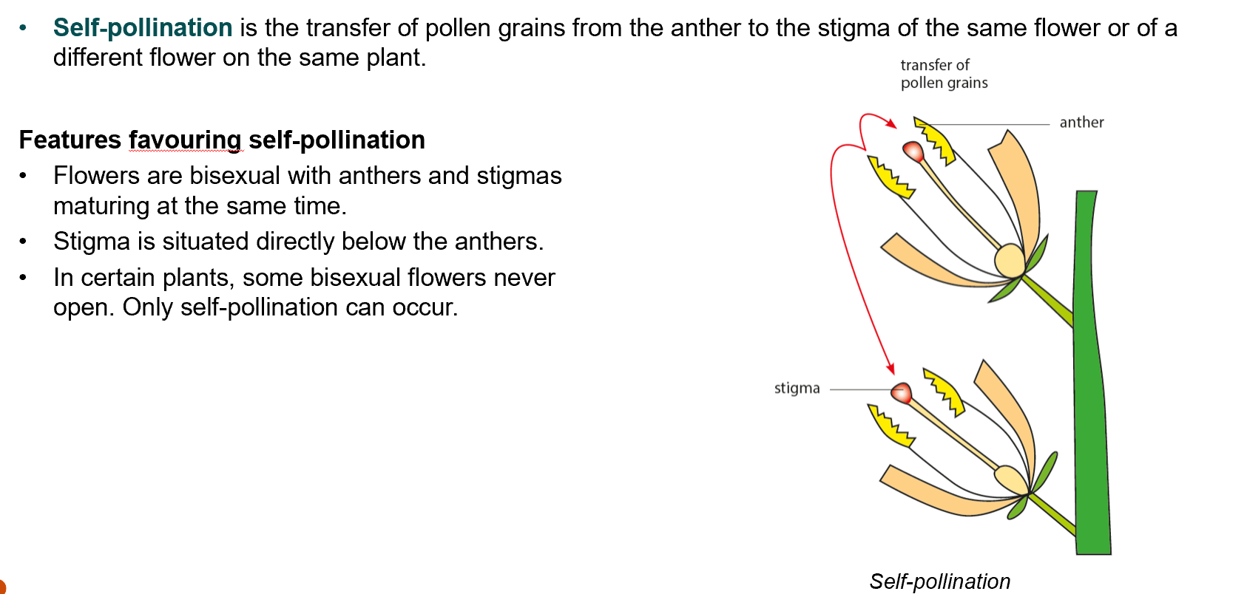
A. What Is self pollination?

Slide 11
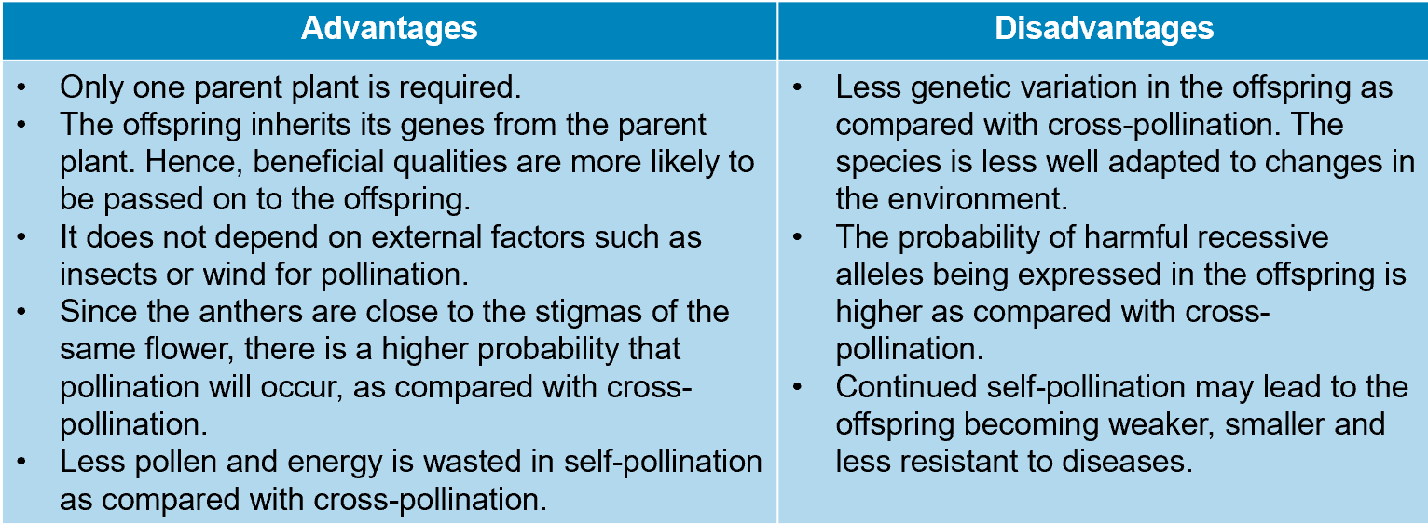
Advantages and Disadvantages of self pollination

Slide 12
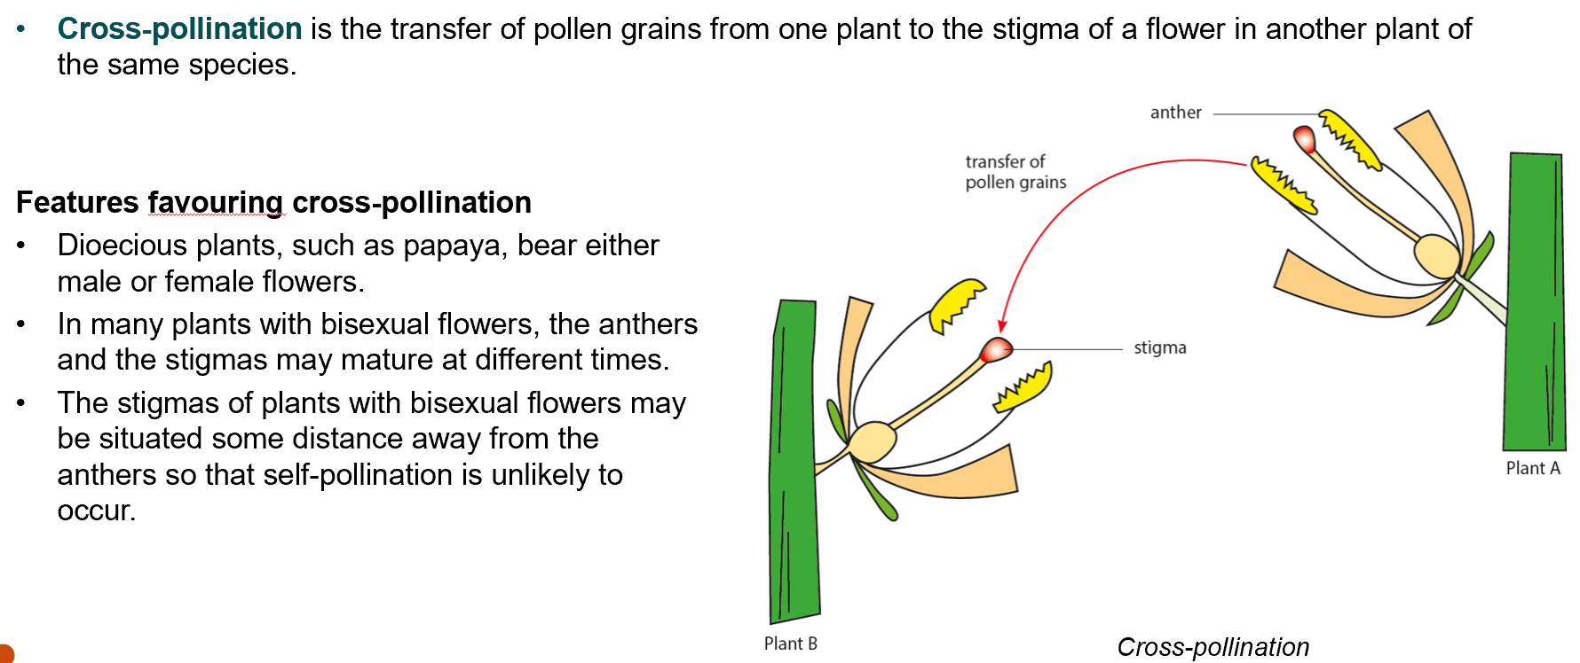
B. What is cross pollination?

Slide 13
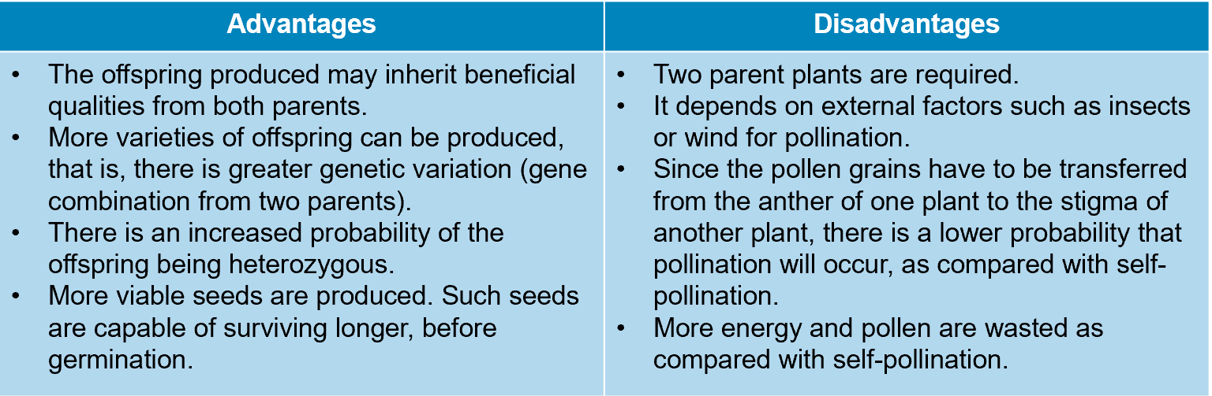
Advantages and disadvantages of cross pollination

Slide 14
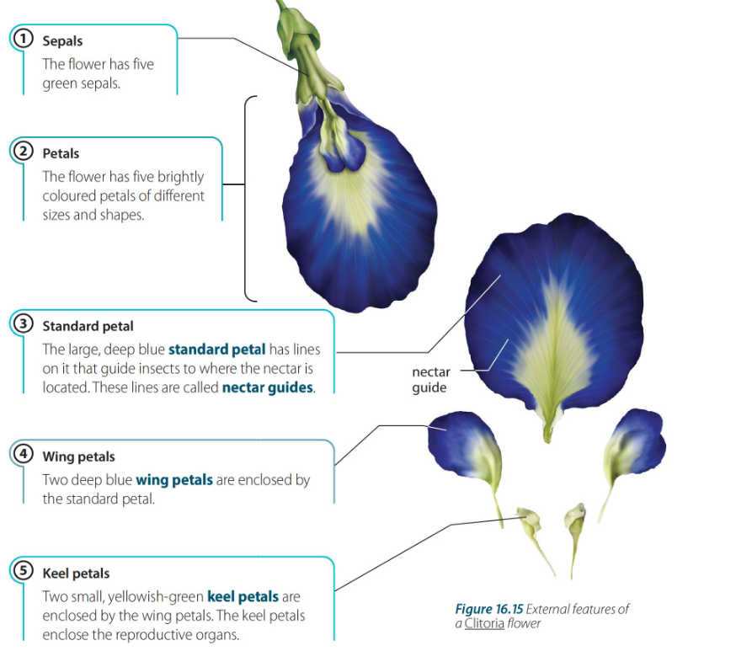
Structural adaptations of an insect-pollinated flower — Clitoria

Slide 15
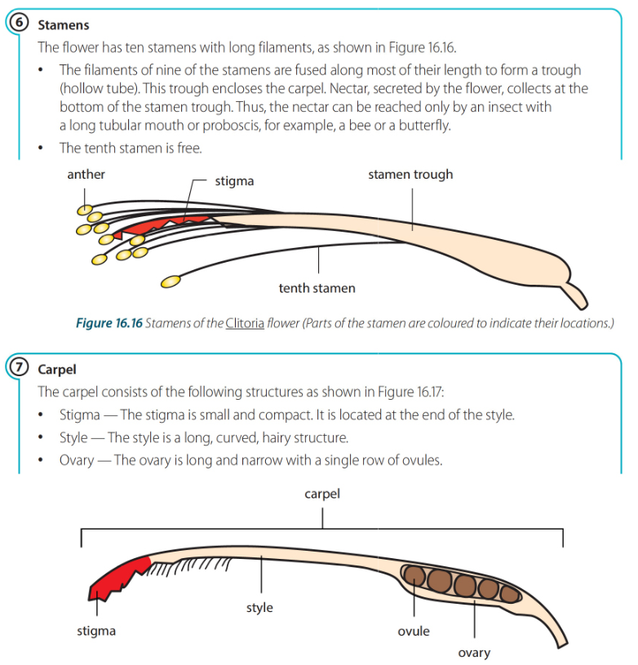

Slide 16
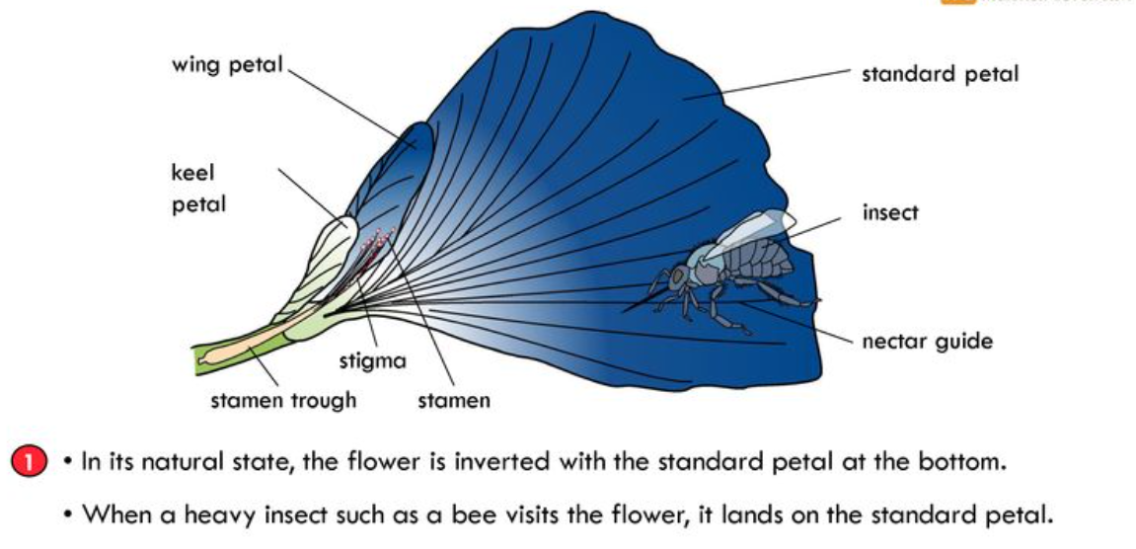
Pollination of Clitoria

Slide 17
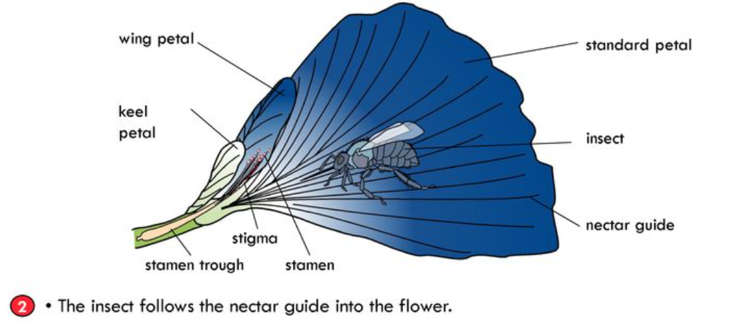
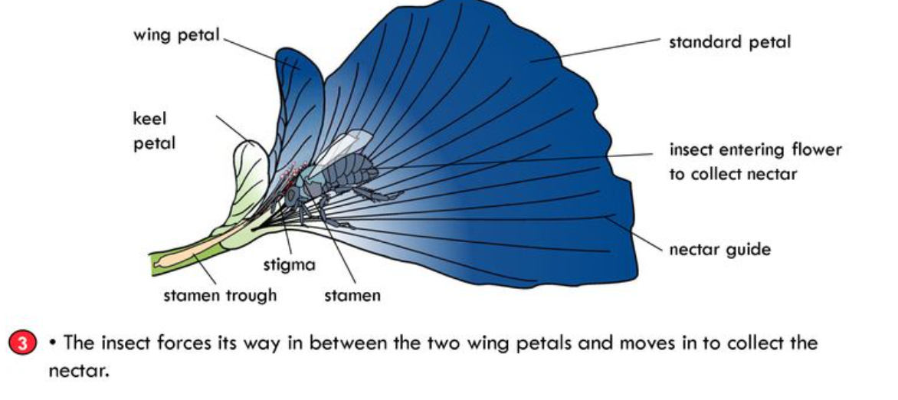

Slide 18
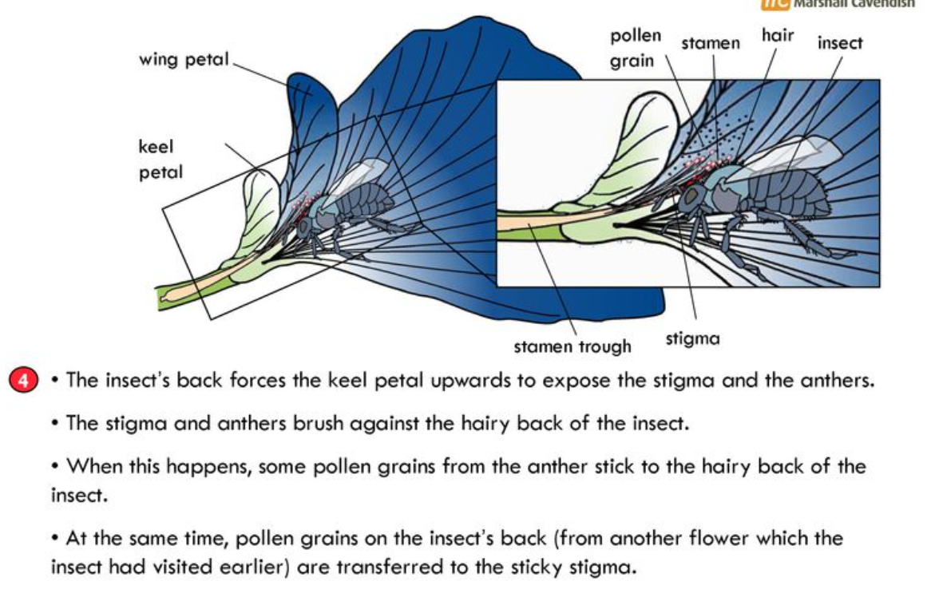

Slide 19
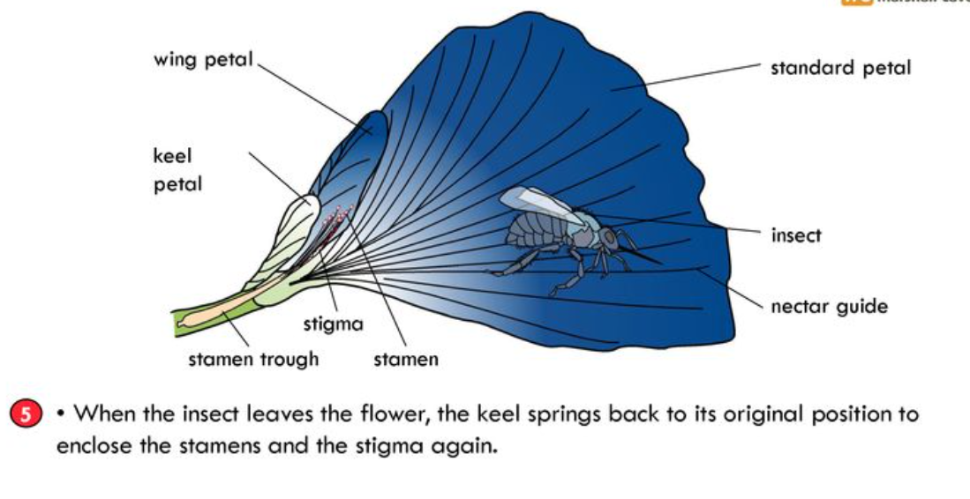

Slide 20
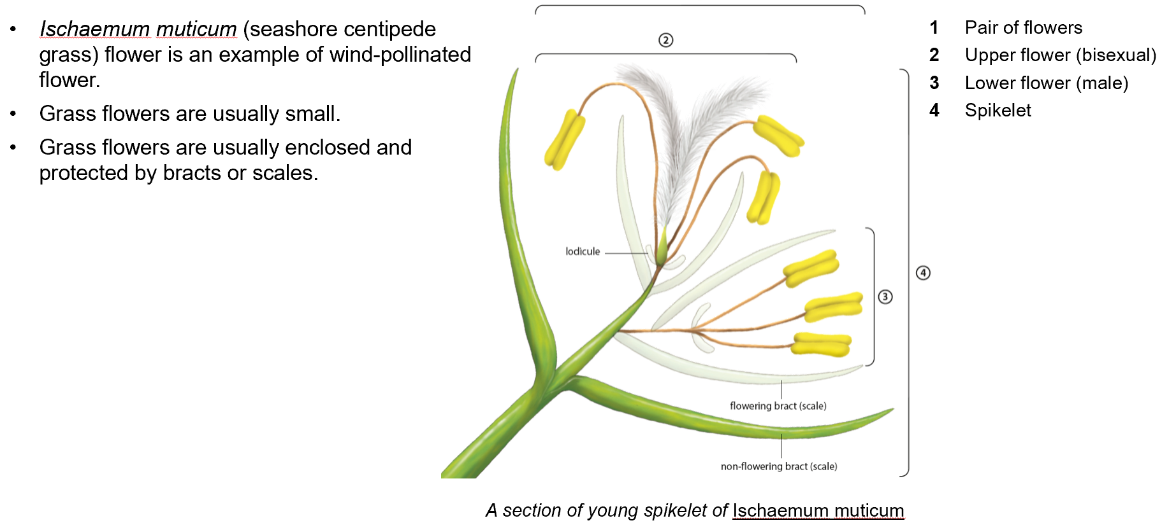
Structural adaptations of a wind-pollinated flower — Ischaemum muticum

Slide 21
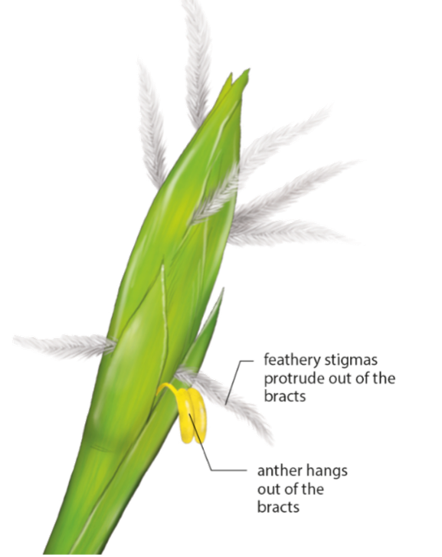
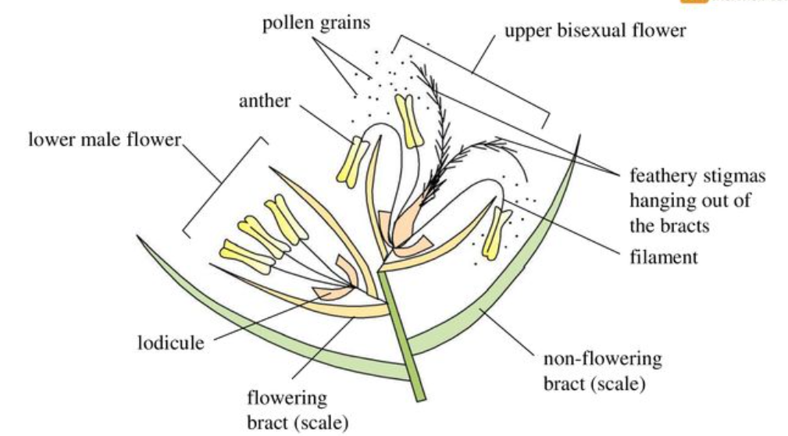
Ischaemum muticum

Slide 22
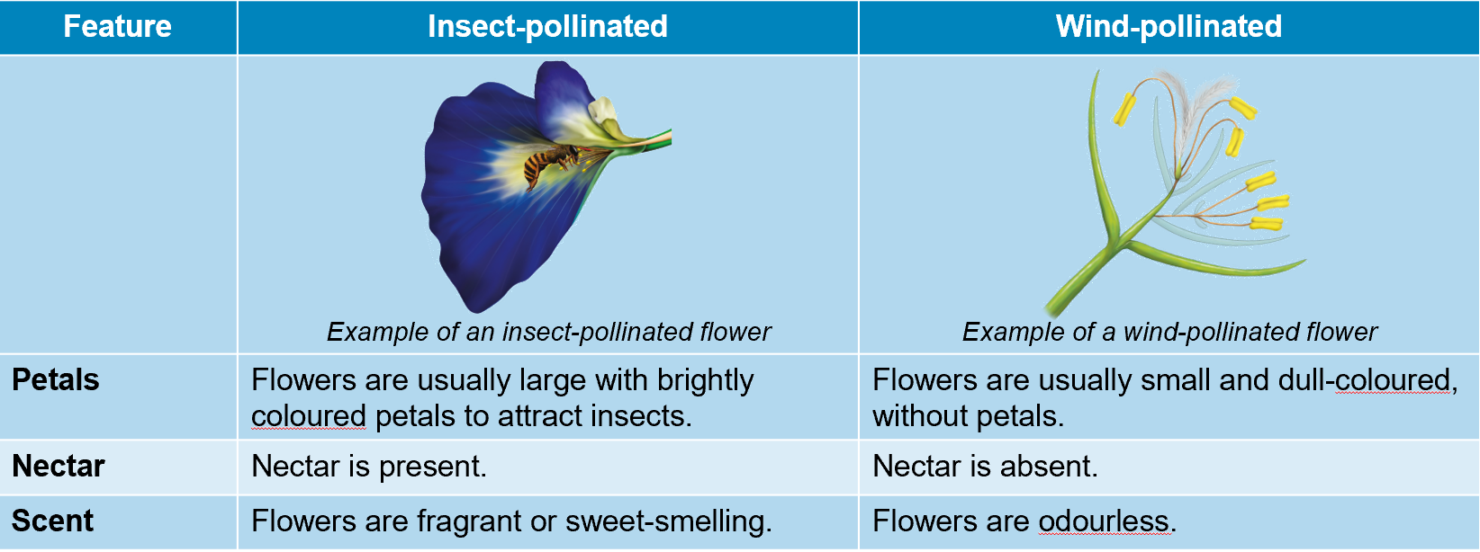
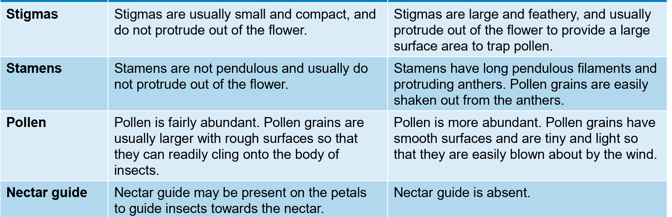
Insect pollination VS Wind pollination

Slide 23
Fertilization
Gametes: Sex cells of living organisms.
In animals the male gamete is called sperm and the female gamete is the egg or ovum.
In plants the male gamete is found in the pollen grain, and the female gamete is the egg cell in the ovule.
Fertilization: Is the fusion of the male and female gametes (exactly their nuclei) to form a zygote.
Zygote: Is the cell which is formed from the fusion of male and female gamete.

Slide 24
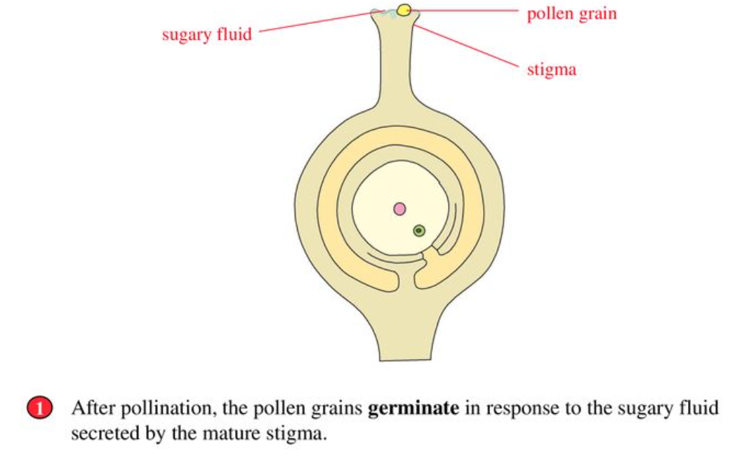
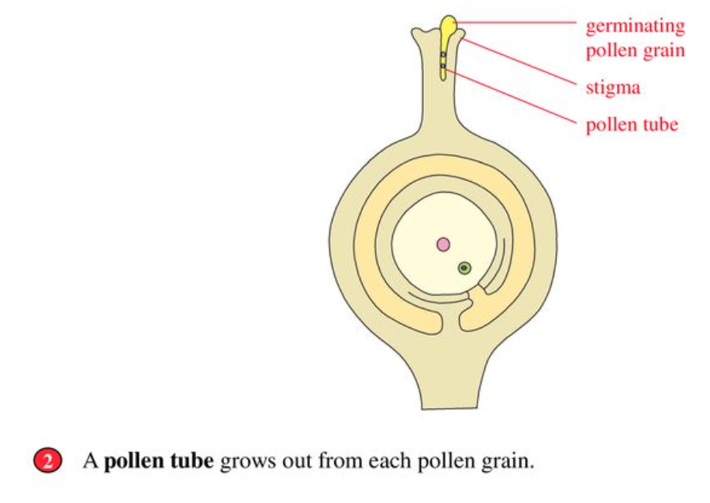
Fertilization

Slide 25
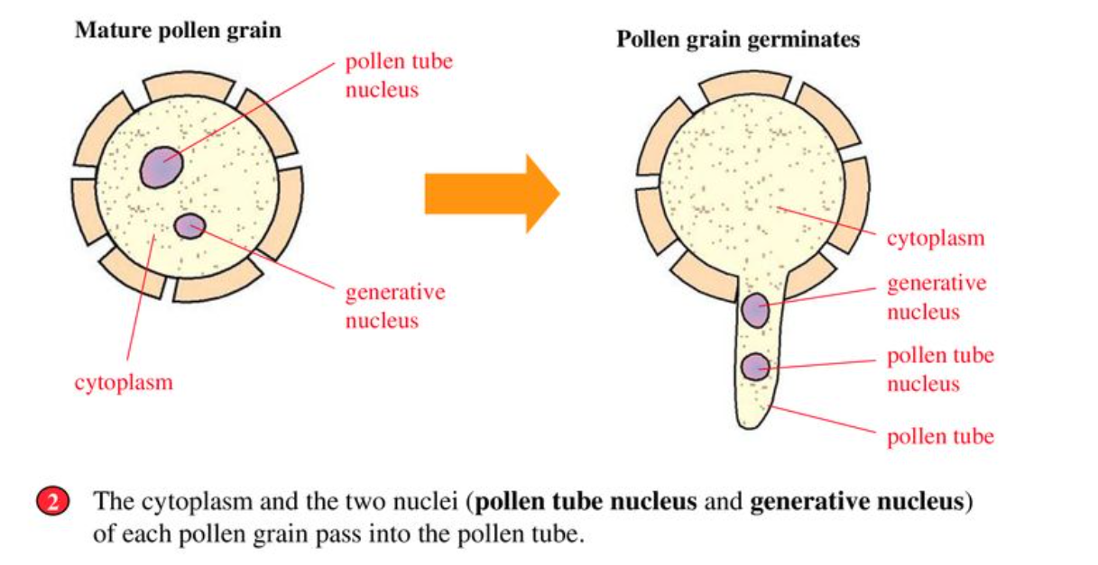

Slide 26
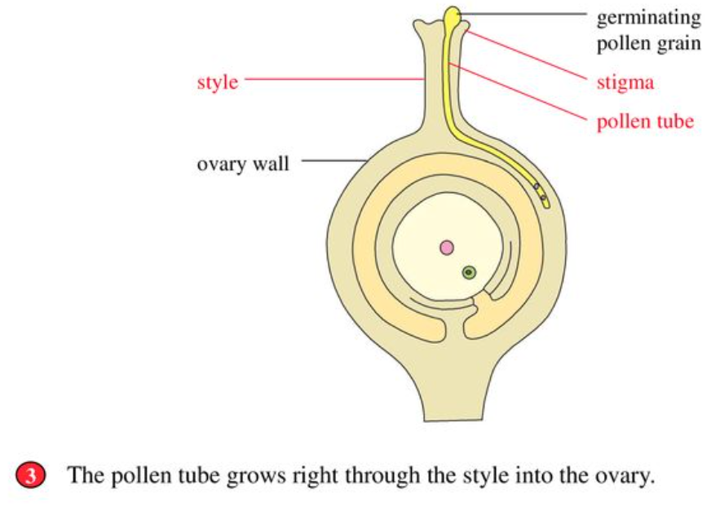
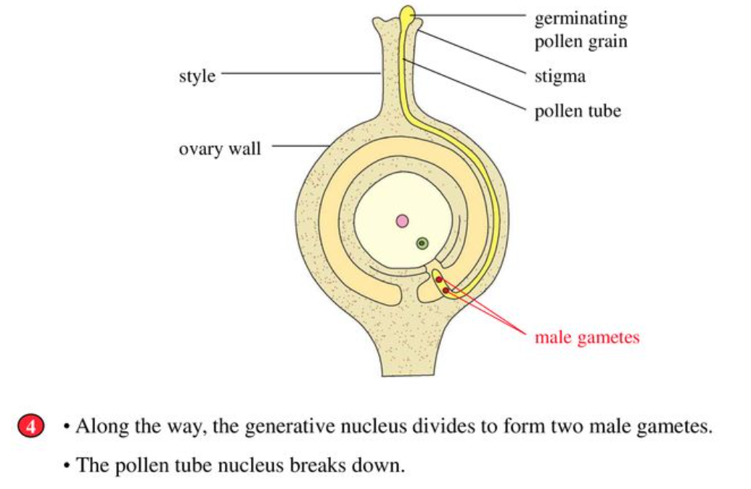
Fertilization

Slide 27
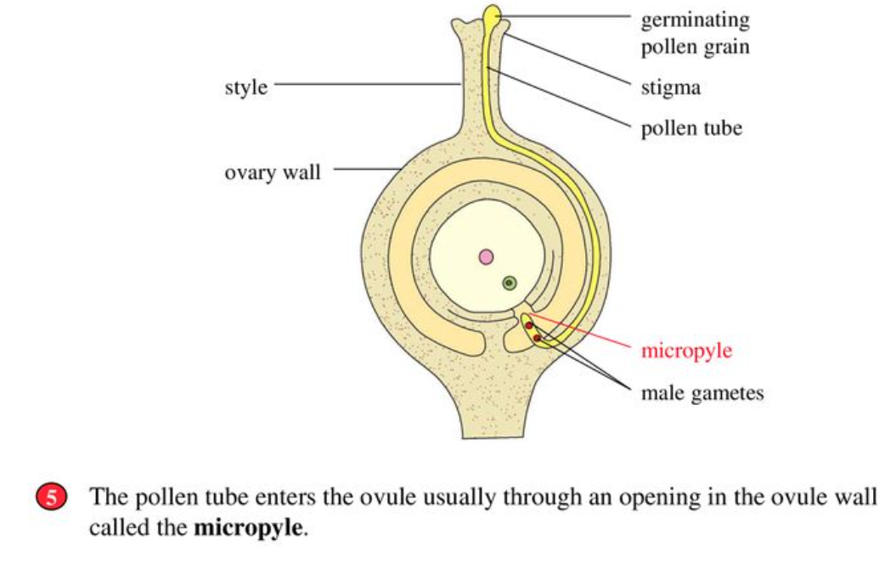
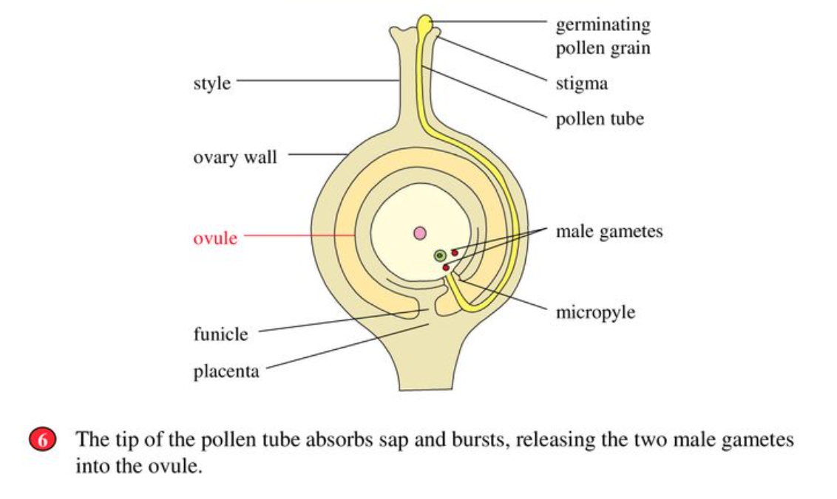
Fertilization

Slide 28
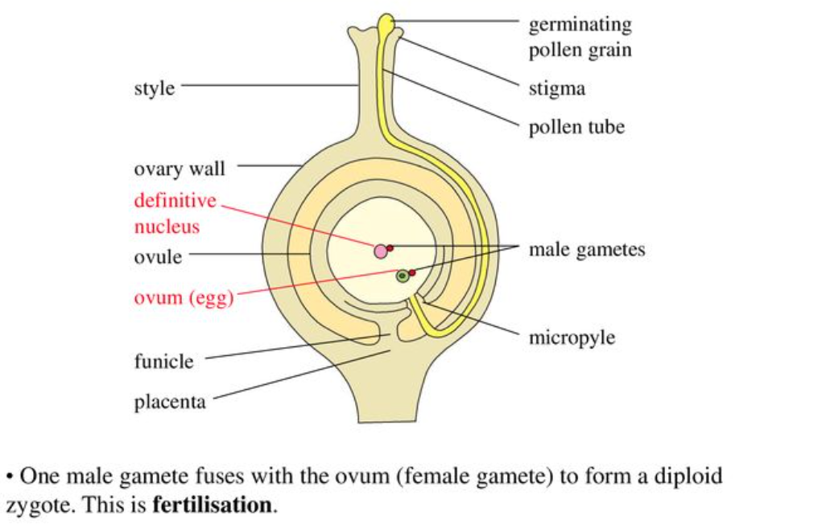

Slide 29
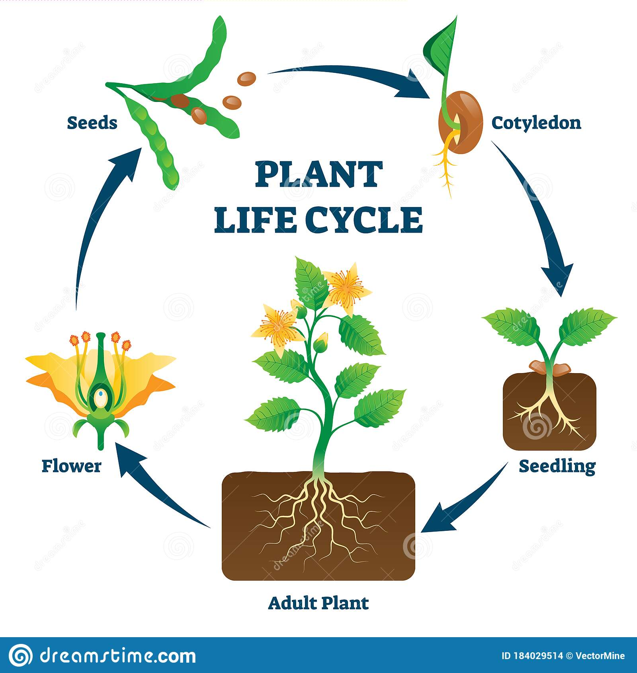
Fertilization
After fertilization: and, an ovule becomes a seed and an ovary becomes a fruit.
Fruit formation: usual case - An ovary becomes a fruit, and the ovary wall becomes the fruit wall (the pericarp).
Stamens and petals shrivel and fall off.
Fruits are two kinds: Fleshy edible fruits: example tomato, orange, cucumber. raspberries and blackberries consist of many small fruits clustered together
Dry not edible fruits: the ovary develops into dry capsule example: wallflower pod. lupin and bean pods at maturity.

Slide 30
Dispersal of fruits and seeds
1)Wind 2)Animals 3) Explosive fruits
Advantages of dispersal
• Dispersal reduces overcrowding and competitions for light and water between members of the same species.
• Dispersal results in plants growing in new places. (if environmental conditions are suitable).
• Dispersal brings about evolution, the varieties that are better adapted to the new environment are selected to survive and reproduce.

Slide 31
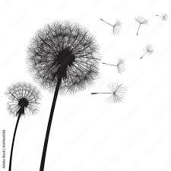
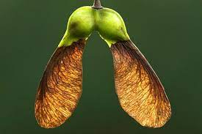
Wind dispersal
A. Dandelion
B. Sycamore (winged fruit)
Pappus of hair projects from the fruit and so increases its surface area. This allows the fruit to float over long distances from the parent plant in slight air currents.
It has a wing-like extension from the ovary wall, which causes the fruit to spin as it falls from the tree and so slow down its fall and carry it away in air currents.

Slide 32
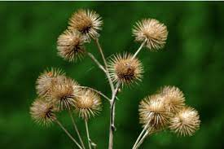
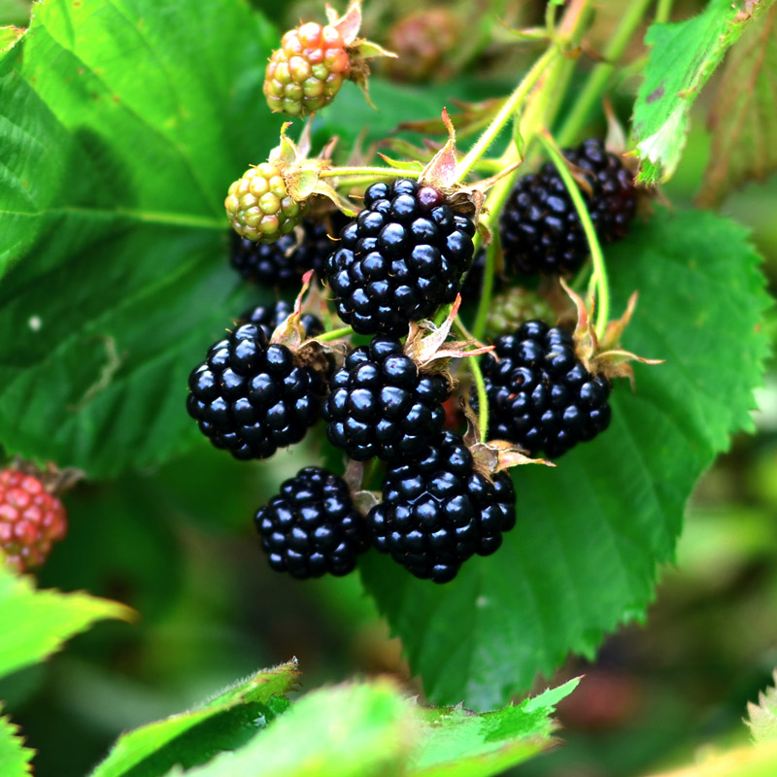
Animal Dispersal
A. Burdock
B. Blackberry
It has hooked bracts, which catch in the fur of passing mammals, and the seeds fall out as the mammal moves about.
When birds and mammal eat these fruits, the hard pips containing the seed are not digested and so pass out with the dropping of the bird away from the parent plant. Adaptation of these fruits to this type of dispersal: • Bright colour: attracts birds and mammals • Soft texture: source of food.

Slide 33
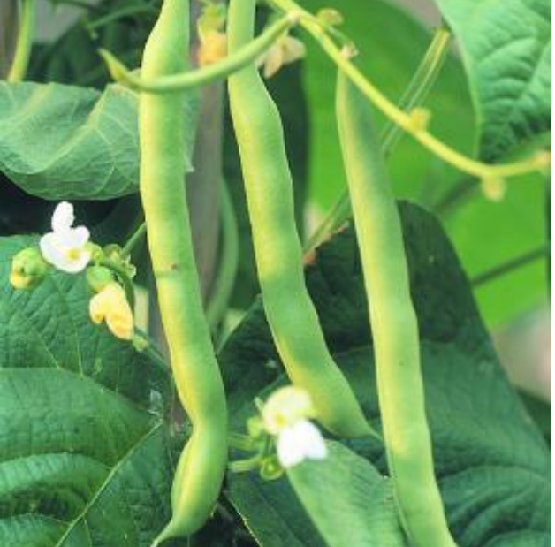
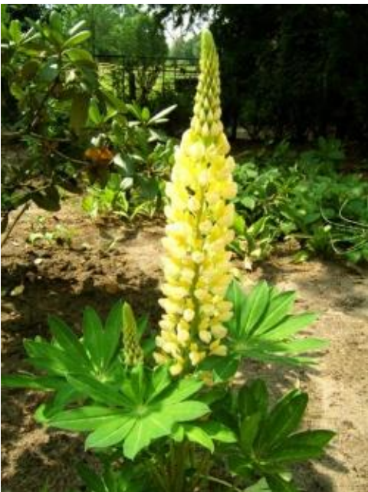
3) Explosive fruits
3) Explosive fruits (e.g. lupin or beans): As the fruit (pod) wall loses water and dries, it splits open (cracks) forcing the seed out of the pod and away from the parent plant.

